Slide 1
Quality Circle Competition
Template & Scores
Company Logo
Page no. compulsory

Slide 2
Compulsory Details:
Company Name:
QC Circle Team Name:
Theme/Topic:
Category: Overall Quality | Cost Reduction | Customer Complaints Reduction | Facility Improvement | Productivity Improvement| Safety
Technical / Non- Technical Team: (Non Technical team comprises only 12th Pass or Non-Technical Graduate)
Company Logo

Slide 3
Problem and Target:
20 Marks- Non Technical Team
24 Marks- Technical Team
Company Logo

Slide 4
Observation and Data collection:
40 Marks- Non Technical Team
40 Marks- Technical Team
Company Logo

Slide 5
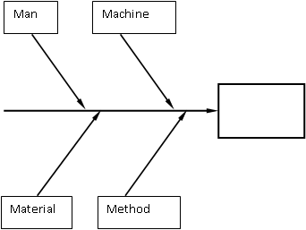
Analysis & Development of solution:
25 Marks- Non Technical Team
25 Marks- Technical Team
Company Logo

Slide 6
Action plan:
10 Mark- Non Technical Team
14 Mark- Technical Team
Company Logo

Slide 7
Check & Benefits:
15 Mark- Non Technical Team
15 Mark- Technical Team
Company Logo

Slide 8
Standardization:
30 Mark- Non Technical Team
24 Mark- Technical Team
Company Logo

Slide 9
Conclusion: Mandatory for Technical Team (Lessons learnt, problems remaining and future plan)
10 Marks- Technical Team
Not Mandatory – Non Technical Team
Company Logo

Slide 10
Saving: Mandatory for Technical Team
8 Marks- Technical Team
Not Mandatory – Non Technical Team
Company Logo

Slide 11
Presentation:
30 Marks- Non Technical Team
10 Mark- Technical Team
10 Marks Bonus Points (Adherence Discipline)- For all Teams
Submission of PPT for Pre-Read. (As per the deadline mentioned by ACMA)
Timely completion of Presentation. (max 12 mins)
Company Logo

Slide 12
Knowledge Test:
20 Marks- Non Technical Team
20 Mark- Technical Team
Company Logo

Slide 13
Total Marks
200 Marks for Technical Team
200 Marks for Non-Technical Team
This includes 10 Marks Disciplinary Bonus Points
Company Logo

